Slide 1


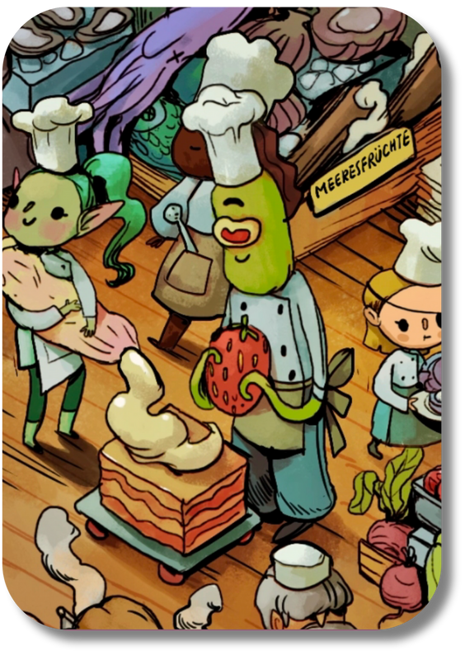
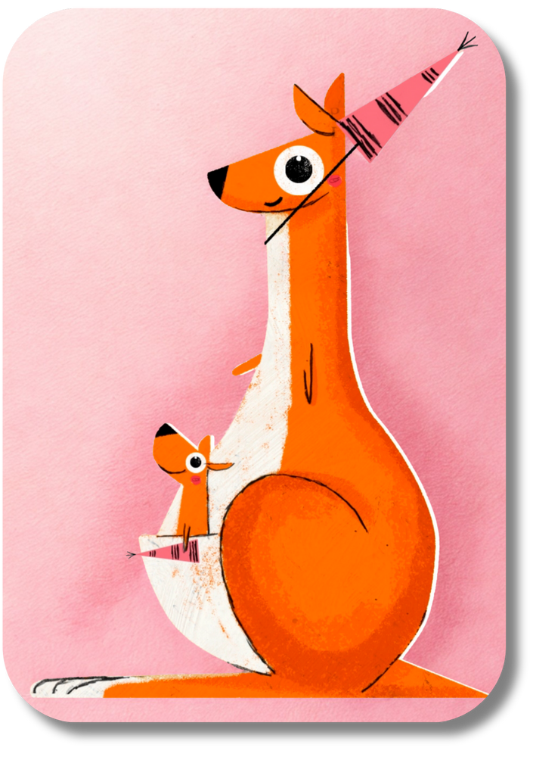
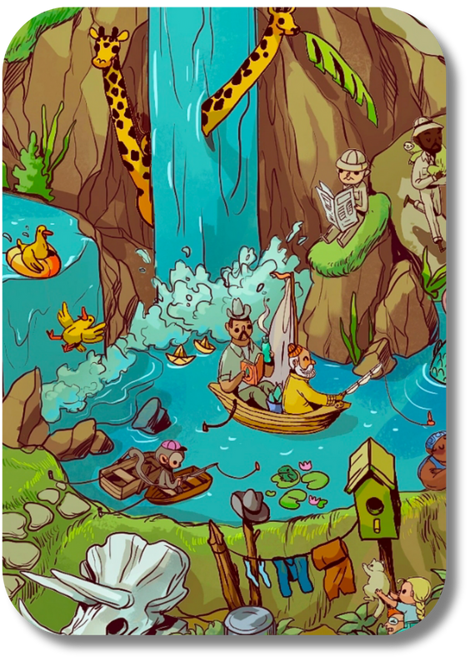

Introducing our new BookSparks cards!

Slide 2






Turn them over to see what they say on the back.

Slide 3

Each card invites us to browse the books on offer.
Which books will you choose?

Slide 4

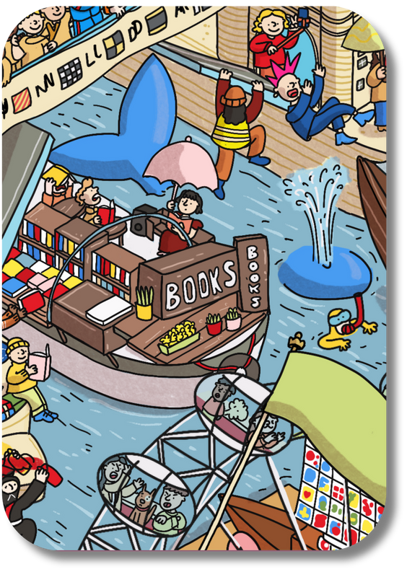

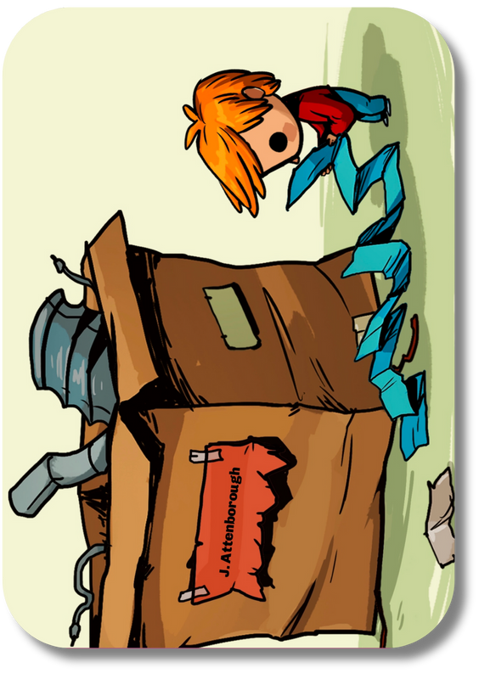
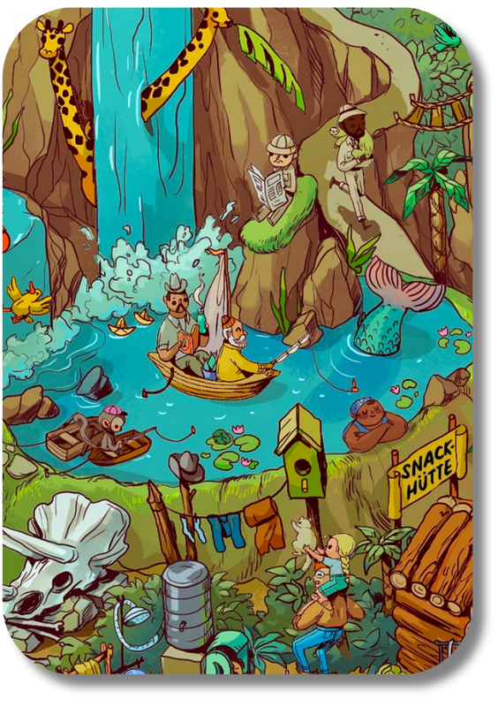


Every card is different.

Slide 5



What will your cards ask you to find?

Slide 6

There are no right or wrong answers!

